Slide 1
Midterm Project - Chatroom
Software Studio 軟體設計與實驗
Hung-Kuo Chu
Department of Computer Science
National Tsing Hua University
CS2410

Slide 2
Goal
Create your chatroom app with Firebase.
Your web page must meet all requirement in basic components then you will get 70%
Add some advance components and bonus components in your web page will get at most 25%
Describing the functions of your website in README.md
You ought to explain how to operate your web, if TAs can’t find the function, you won’t get the points.

Slide 3
Basic components
Membership Mechanism (15%)
Email Sign Up
Email Sign In
Host your Firebase page (5%)
Use Firebase Hosting to host your page and check it working fine
Database read/write (15%)
Read/Write your membership data, or other usefull data in authenticated way
RWD (15%)
Check your website working fine on different size device

Slide 4
Basic components
Chatroom (20%)
Can create private chatrooms to chat with other members register in this website
Other members can see your messages in chatroom
Load all history message of current chatroom

Slide 5
Advanced components
Using React (10%)
Sign Up/In with Google or other third-party accounts (1%)
Add Chrome notification (5%)
Use CSS animation (2%)
https://www.youtube.com/watch?v=bjUoQbSJDJs
Deal with problems when sending code (2%)
<script>alert(“example”);</script>
<h1>example</h1>

Slide 6
Bonus Components
Bonus Components (at most 5%)
User profile (1%)
Profile picture (1%)
Send image (1%)
Send video (1%)
Chatbot (2%)
Block User (2%)
Unsend message (3%)
Search for message (3%)
Send gif from Tenor API (3%)

Slide 7
Scoring
Item | Score
Basic components | 70%
Advance components | 20%
Total Completeness (subjective) | 10%
Bonus components | 5%
Total | 105%

Slide 8
Reminder
Deploy your web page to Firebase page, and ensure it works correctly. Add TA’s account to your firebase project.
Your main page should be named as “index.html”
Upload source code to FTP.
Compress files into Midterm_Project_學號.zip then upload
index.html, .css, .js, README.md, etc.
Do not add node_modules into zip file.
If you upload the files again, please change the filename become Midterm_Project_學號_v?.zip (v? -> which version)
MD5 checksum (if you didn’t do this → -10%)
FIRM deadline: 2022/04/24 23:59 (commit time)
Upload your MD5 and web link to eeclass

Slide 9
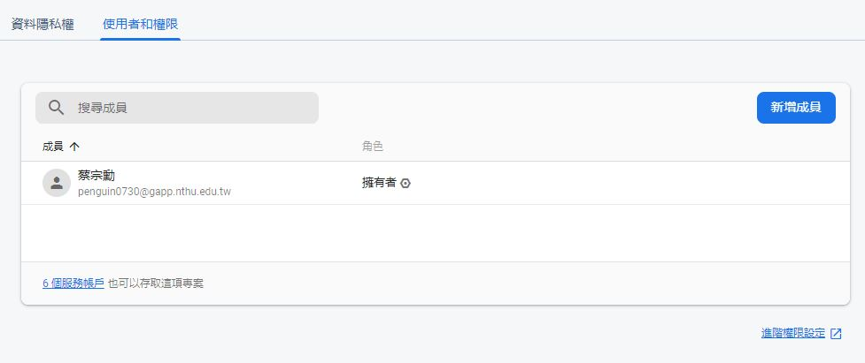
Add permission to TA’s account
Go project setting and select “Users and permissions”

Slide 10
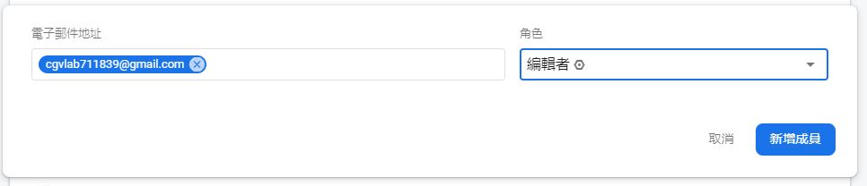
Add permission to TA’s account
Add cgvlab711839@gmail.com as editor to your project.

Slide 11
作業規則
程式碼嚴禁抄襲，抓到抄襲者，抄襲與被抄襲者
直接當掉！直接當掉！直接當掉！
直接當掉！直接當掉！直接當掉！
…
繳交期限為兩個星期，不得遲交。
沒有屍體分數！
評分方式以日後公布為主。
Notes:
2021 抄襲改成直接當掉

Slide 12
作業繳交規則
請務必透過 MD5 獲得作業checksum 後填入 google 表單。
如遇各種原因無法在作業期限前完成上傳，我們將比對 checksum。若 checksum 一致則不算遲交。
繳交作業以MD5為主，若有多個 checksum 則取時間最晚的為主。
MD5 online generator
MD5 checksum 登記表單
MD5 checksum 登記查看
MD5 使用方法

Slide 13
作業繳交流程
請務必遵守以下規則：
將作業打包壓成zip檔，檔名格式以及打包內容以當次作業公告為主。
幫zip檔產生MD5，並填寫google表單。
將zip檔上傳ftp。
將MD5和網址繳交至eeclass。
若違反任何一項繳交作業SOP，
一律扣作業總分10分！！！
貼心提醒：請同學守護zip檔至作業成績公告或期末。
Notes:
2021 新增作業繳交流程

